Slide 1

Rockbuster Stealth LLC
2020 Company Strategy

Slide 2
Key Questions and Objectives
Plan – To use existing movie licenses to launch an online video rental service in order to stay competitive with other streaming services such as Netflix and Amazon Prime
Questions –
Which movies contributed the most/least to revenue gain?
What was the average rental duration for all videos?
Which countries are Rockbuster customers based in?
Where are customers with a high lifetime value based?
Do sales figures vary between geographic regions?

Slide 3
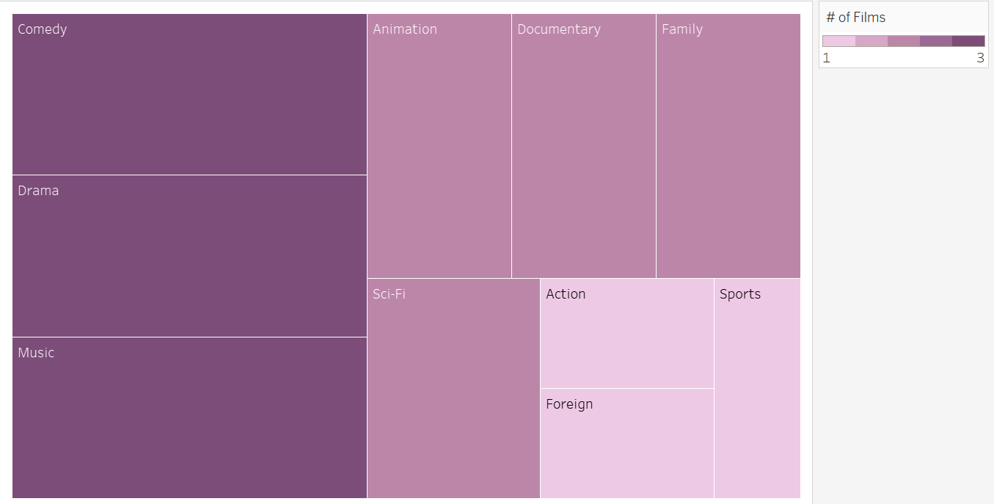
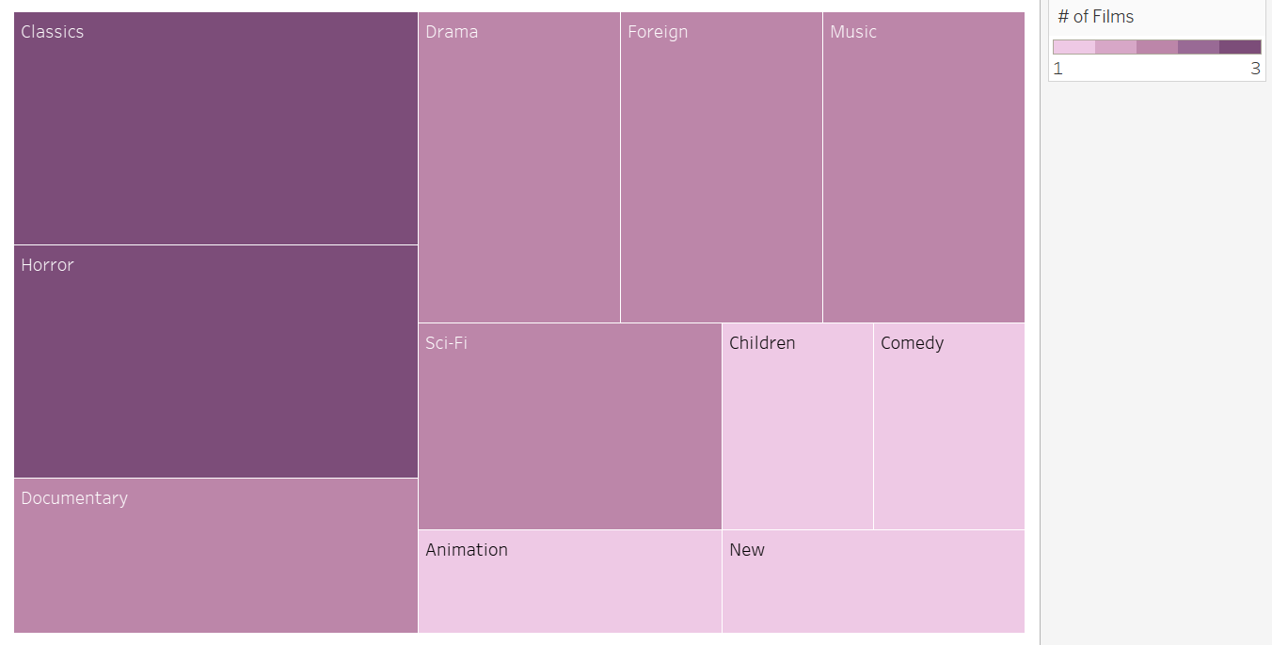
Does Genre Impact Revenue Gain?
Using a Comparison of the 20 Top and Lowest Grossing Films
Top Grossing Films
Least Grossing Films

Slide 4
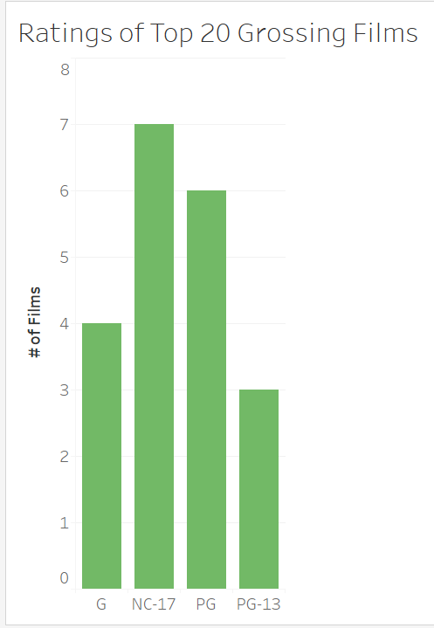
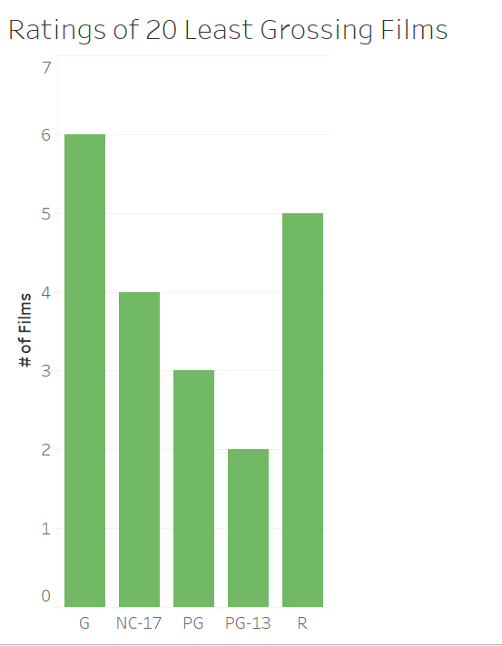
Does Rating Impact Revenue Gain?
Using a Comparison of the 20 Top and Lowest Grossing Films
Top Grossing Films
Least Grossing Films

Slide 5
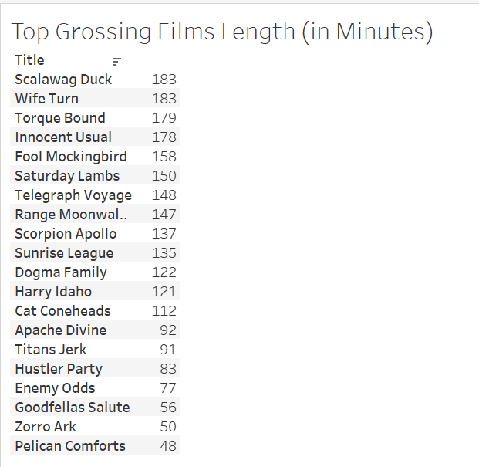
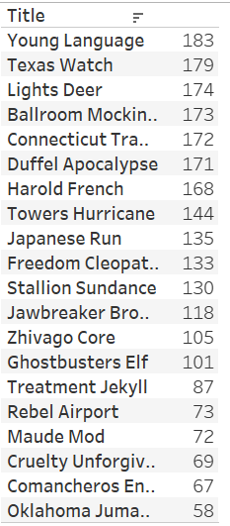
Does Length of Film Impact Revenue Gain?
Using a Comparison of the 20 Top and Lowest Grossing Films
Top Grossing Films
Least Grossing Films

Slide 6
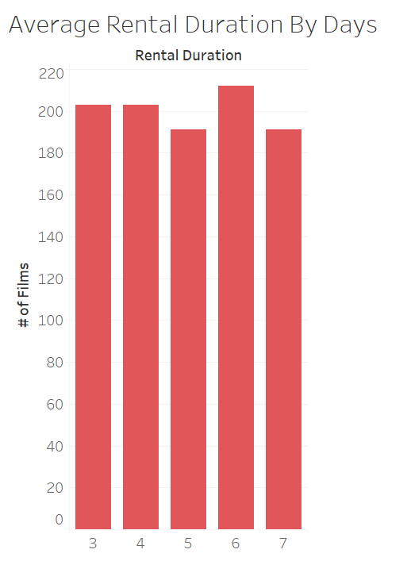
How Many Days Do Customers Rent Films For?

Slide 7
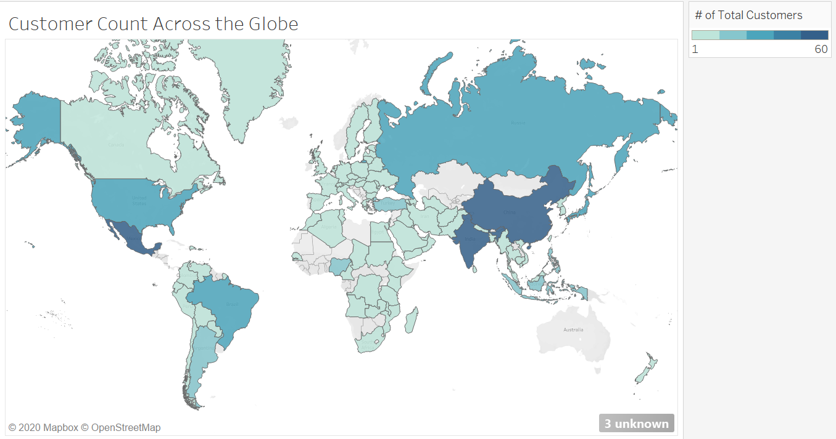
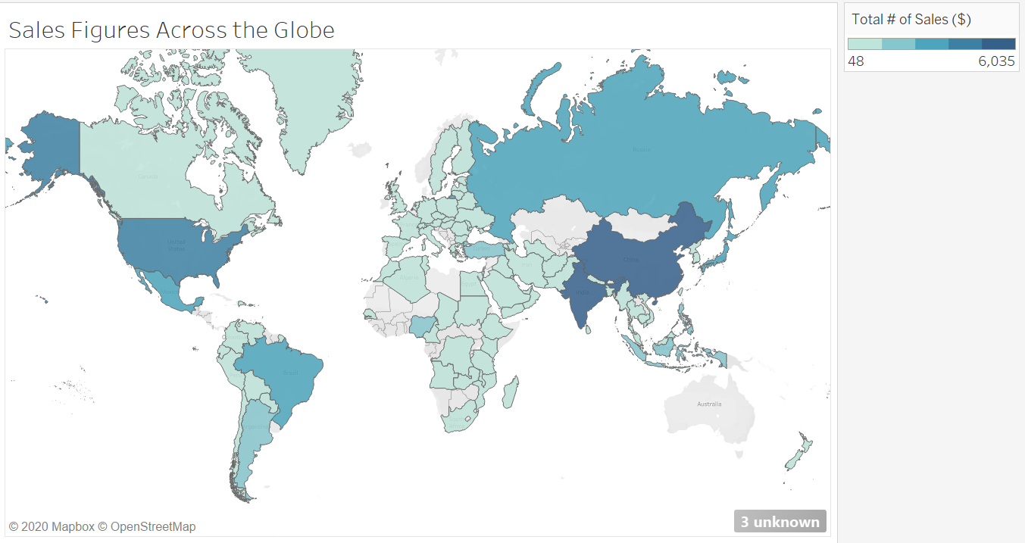
Does the Number of Customers in a Country Impact Sales?
Total Customers By Country
Sales Figures By Country

Slide 8
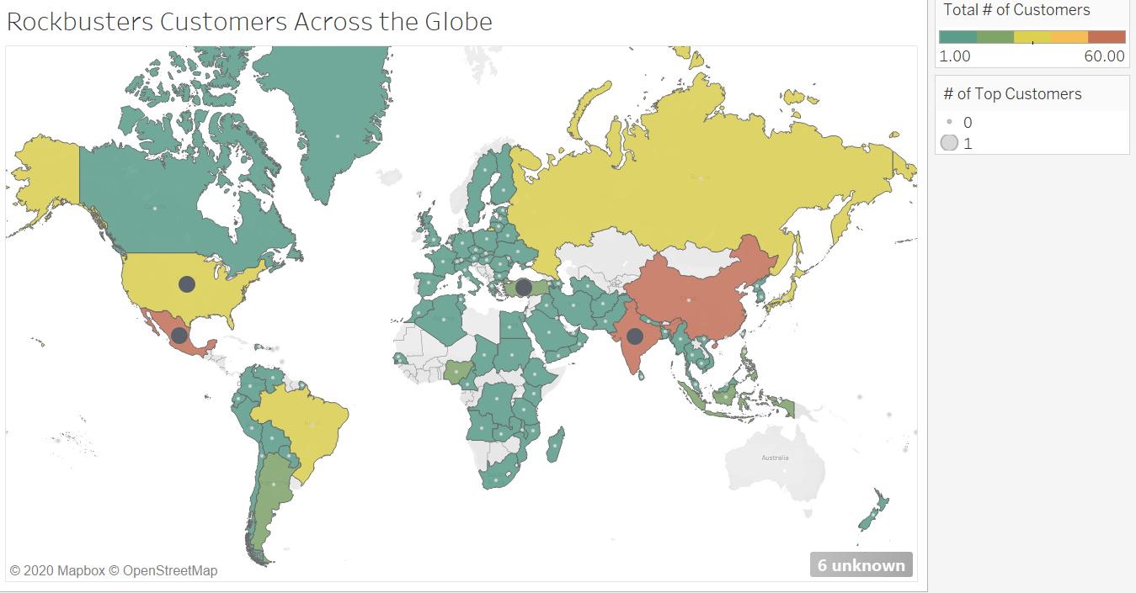
Where Do the High Lifeline Customers Live?

Slide 9
Observations and Results
Certain genres are more popular than others
These include Comedy, Drama, Music, Action, and Sports
Low performing genres include Classics, Horror, New, and Children
Particular rating categories also performed better
NC-17 films are the highest selling followed by PG
Films rated G and R had the lowest revenue
Length of film did not appear to impact revenue
Majority of films in the top and bottom grossing groups were over 120 minutes long

Slide 10
Observations and Results - Continued
Number of days films were rented did not differ greatly
6 days was the most popular rental duration time
Total number of Rockbuster customers located in a country appears to impact sales figures
China, India, Mexico, Russia, United States, and Brazil all have the largest amount of customers and the highest sales figures
Certain geographic regions performed better from a revenue standpoint
Asia and the Americas had the highest sales
Europe and Africa had the lowest sales figures
High lifetime Rockbuster are customers located in high revenue performing countries
These customers found in countries such as United States, Mexico, and India

Slide 11
Recommendations
Focus on promotion of films in high-performing categories
Genres of Comedy, Drama, Music, Action, and Sports
Ratings of NC-17 and PG
Allow rental duration time to remain the same
3-7 days

Slide 12
Recommendations - Continued
Continue promotion of services in high performing countries as well as across Asia and the Americas
Evaluate increasing advertising in low performing regions including Europe and Africa in order to increase customer base and sales
Survey high lifetime customers
Ask questions to determine what keeps them using Rockbuster and what can be done to improve current services
Complete further surveys and analysis to determine how to improve services compared to other competitors
Focus on pricing, inventory, incentives, streaming capabilities

Slide 13
Additional Information
Link to Tableau Visualizations
https://public.tableau.com/profile/courtney4279#!/vizhome/3_10Graphs/CountrySales

